Slide 1
CHAPTER TWO: F-block elements
F-blocks

Slide 2
F-block elements
The elements in which the last electron enters in the anti-penultimate f-subshell are called f-block elements
Because of filling of electrons in the f-orbitals of an inner shell, these elements are also termed as inner-transition elements
These elements form a transition series within the transition elements.
The f-block elements comprise two series of elements-lanthanide series and the actinide series
The two series of elements in the f block derive from the filling of the seven 4f and 5f orbitals, respectively

Slide 3
General Properties
Physical Properties
The metals are silvery white in colour.
Generally, they have high melting and boiling points and are very hard.
They are good conductors of heat and electricity.
Many of the f-block metal ions form coloured ions.
They exhibit paramagnetism because of the presence of unpaired electrons.
They have high density.

Slide 4
Chemical Properties
In chemical reactivity, they resemble calcium.
They readily tarnish in air and burn to give trioxides (except Ce which forms CeO₂).
They also combine with non-metals –N, S, halogens, H.
The hydrides are non stoichiomtric but have a composition of MH₃. These hydrides liberate hydrogen from water.
The lanthanides also liberate hydrogen from water and a vigorous evolution of same gas from dilute non-oxidizing acids.
Generally, Lanthanide compounds are predominantly ionic.
The compounds usually contain lanthanide metal in its +3 oxidation states.

Slide 5
Lanthanide series (Ce, Z=58 –Lu, Z=71)
This series starts from Lanthanum and continues up to Lu (Lutetium)
They are characterized by the filling up of the antipenultimate 4f energy levels
Are called lanthanides, Lanthanoids, lanthanons, or rare earth elements
Their name arise from lanthanum (La, Z=57) because they come immediately after lanthanum (La)
They include fourteen elements from cerium (Ce, Z=58) lutetium (Lu, Z=71)
All the elements of the lanthanide series resemble each other very closely due to
the presence of the same number of electrons in the outermost and the penultimate shells
Though Lanthanum is a d- block element it is included in the lanthanides series as it resembles them in chemical and physical properties

Slide 6
Occurrence in Nature
Apart from promethium which is unstable and is found in traces in uranium ores, all the lanthanides generally occur together
However, each mineral contains different concentrations of the individual Lanthanides.
The main mineral sources of lanthanides are:
Monazite: contains mostly the lighter Lanthanides.
Xenotime: contains mostly the heavier Lanthanides.
Euxenite: contains a fairly even distribution of the Lanthanides
Bastnaesite: is a mixture of fluoride carbonates, LnFCO₃, of lanthanum and the lanthanides and is richer in the lighter lanthanides
In all the ores, the atoms with an even atomic number are more abundant

Slide 7
Electronic configuration
The general electronic configuration is [Xe](n-2)f¹⁻¹⁴(n-1)d⁰⁻¹ ns² or [Xe]4f¹⁻¹⁴5d⁰⁻¹ 6s²
All have electronic configuration with 6s² in common but variable occupancy of 4f and 5d-subshells due
to the closeness in energy of 4f and 5d electrons
So it is considered that the 5d orbital remains vacant and the electrons enter into the 4f orbital.
Exceptions
in case of Cerium, Ce(Z=58), an electron enters the 5d orbital due to comparable energies of 4f and 5d orbitals
in the case of gadolinium, Gd (Z= 64 ), an electron enters the 5d orbital to have stable half-filled configuration
in Ytterbium (Z=70), all the 4f orbitals are completely filled to have stable configuration
in lutetium (Z=71) the differentiating electron enters the 5d orbital
But the electronic configurations of all the tripositive ions are of the form 4f^{n}(n=1 to 14 with increasing atomic number).

Slide 8
Electronic configuration of Lanthanide series
Name | Symbol | Z | Electronic Configuration |  | Metallic Radius (pm) | Ionic radius Ln³⁺ (pm) | E⁰(V) Ln³⁺/ Ln | Color of Ln³⁺
 |  |  | Ln | Ln³⁺
Lanthanum | La | 57 | (Xe)5d¹6s² | 4f⁰ | 187 | 106 | -2.52 | colorless
Cerium | Ce | 58 | (Xe)4f¹5d¹6s² | 4f¹ | 183 | 103 | -2.48 | colorless
Praseodymium | Pr | 59 | (Xe)4f³6s² | 4f² | 182 | 101 | -2.46 | Green
Neodymium | Nd | 60 | (Xe)4f⁴6s² | 4f³ | 181 | 99 | -2.43 | Lilac
Promethium | Pm | 61 | (Xe)4f⁵6s² | 4f⁴ | 181 | 98 | -2.42 | Yellow
Samarium | Sm | 62 | (Xe)4f⁶6s² | 4f⁵ | 180 | 96 | -2.41 | Yellow
Europium | Eu | 63 | (Xe)4f⁷6s² | 4f⁶ | 199 | 95 | -2.41 | Pale pink
Gadolinium | Gd | 64 | (Xe)4f⁷5d¹6² | 4f⁷ | 180 | 94 | -2.40 | colorless
Terbium | Tb | 65 | (Xe)4f⁹6s² | 4f⁸ | 178 | 92 | -2.39 | Pale pink
Dysprosium | Dy | 66 | (Xe)4f¹⁰6s² | 4f⁹ | 177 | 91 | -2.35 | Yellow
Holmium | Ho | 67 | (Xe)4f¹¹6s² | 4f¹⁰ | 176 | 89 | -2.32 | Yellow
Erbium | Er | 68 | (Xe)4f¹²6s² | 4f¹¹ | 175 | 88 | -2.30 | Rose pink
Thulium | Tm | 69 | (Xe)4f¹³6s² | 4f¹² | 174 | 87 | -2.28 | Pale green
Ytterbium | Yb | 70 | (Xe)4f¹⁴6s² | 4f¹³ | 194 | 86 | -2.27 | Colorless
Lutetium | Lu | 71 | (Xe)4f¹⁴5d¹6s² | 4f¹⁴ | 174 | 85 | -2.26 | Colorless

Slide 9
Atomic and ionic sizes
In Lanthanide series the size of the elements are decreased in the series due to Lanthanide contraction.
Lanthanide contraction-the steady decrease in the size of the atoms and ions of the rare earth elements with
increasing atomic number from lanthanum (z=57) through lutetium (z=71)
It is caused due to imperfect shielding of one f electron by another in the same shell.
This results an increase in the effective nuclear charge which causes contraction in size of the electron cloud.
The decrease in size is not regular throughout the lanthanides.
A rapid decrease is seen only in the first six elements compared to the rest of the elements

Slide 10
Consequences of lanthanide contraction
1. Similarity of second and third transition series
Generally the size of atoms increases down a group
So the size of the atoms of an element of second transition series is larger than any atom of the first transition series
but the size of the atom of third transition series is nearly same as that of the atom of the second transition series
For example- radius of Zr radius of Hf & radius of Nb radius of Ta etc.
2. Difficulty in the separation of lanthanides
As there is small change in the ionic radii of lanthanides so their chemical properties are similar.
This makes the separation of elements in the pure state difficult
3. Effect on the basic strength of hydroxides
As the size of lanthanides decreases from La to Lu, the covalent character of the hydroxides increases
Thus, their basic strength decreases. E.g., La(OH)₃ is more basic and Lu(OH)₃ is least basic

Slide 11
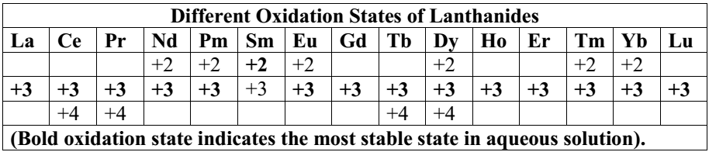
Oxidation States
Most lanthanide elements exhibit the oxidation state +3 predominantly
Occasionally +2 and +4 can occur; this irregularity arises mainly from the extra stability of empty; half filled or filled f-subshell
Ln⁺² oxidation states are good reducing agent whereas Ln⁺⁴ oxidation states are good oxidizing agent to attain stable oxidation state of the lanthanide elements(+3).
Color Formation
The lanthanide ions with +3 oxidation state are colored both in solid state and in aqueous solution (except Ce,Gd, Yb and Lu- colorless)
The color of a cation depends on the number of unpaired f electrons.
The lanthanide ions all show absorptions in the visible or near UV- regions of the spectrum, except for Lu³⁺ which has full f shell
These colours arise from f-f transitions

Slide 12
Melting and boiling point
They have fairly high melting point and boiling point but there is no definite trend in the melting and boiling point of lanthanides.
Density
They have high density ranging between 6.77 to 9.74 g/cm³. It increases with increasing atomic number
Complex formation
Ions of lanthanide elements have a strong tendency to form complexes with a variety of oxygen and nitrogen donor ligands
Ln³⁺ forms complexes of high coordination numbers
The order of complex formation can be best represented as Ln⁴⁺ > Ln³⁺ > Ln²⁺
They form complexes mainly with strong chelating agents such as
H₂O, EDTA, β-diketonate, citric acid, oxalic acid ligands etc.
No complexes with π-bonding ligands are known

Slide 13
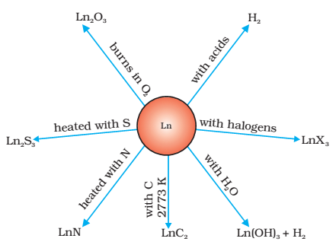
Reactivity
Since all the lanthanides have similar outer electronic configuration and display mainly +3 oxidation state in their compounds, they have nearly similar chemical properties
4f electrons are screened effectively by 5s and 5p orbitals i.e. 4f electrons don’t involved in normal chemical reaction.
Lanthanoids form carbides, nitrides, sulphides, and oxides when heated with carbon, nitrogen, sulphur, and oxygen respectively. They react with acids to give off hydrogen when heated gently. They also form hydroxides with water.

Slide 14
Magnetic Properties
Lanthanides have strong magnetic movement than outer transition elements
due to a large number of unpaired electrons in f orbitals
The states f⁰ and f¹⁴ which occur in La³⁺, Ce⁴⁺ and Lu³⁺ have no unpaired electrons and are diamagnetic
The lanthanoid ions other then the f ⁰ type (La³⁺ and Ce⁴⁺) and the f¹⁴ type (Yb²⁺ and Lu³⁺) are all paramagnetic
Lanthanides have very high magnetic susceptibilities
due to their large numbers of unpaired f-electrons

Slide 15
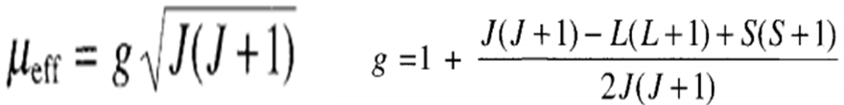

The magnetic moment containing both spin and orbital contributions for f-block elements can be calculated as:
or
Where, g is Lander splitting factor (gyromagnetic ratio), J is coupling constant i.e.
J = L+S, L+S-1………………….. |L-S|
J=L-S for less than half filled,
J=L+S for greater than half filled.
if the subshell is half-filled, L = 0 and then J = S.
L and S are the sum of subsidiary quantum number and spin quantum number, respectively

Slide 16
E.g., Pr³⁺, 4f²

Slide 17



Example 2: Calculate the spin–orbit coupling magnetic moment of Tb³⁺ with f⁸ configuration. It can be calculated as follows:
Since it is more than half filled, the value of J=L+S= 6.
Hence, for f⁸ configuration, the ground state term symbol is ⁷F₆.
Example 3: Calculate the magnetic moment of Nd³⁺ ion(4f³), with the ground state ⁴I_{9/2}. (g_{J}= 0.7273)
Ans: The Nd³⁺ ion has 4f³ configuration and the ground state term symbol ⁴I_{9/2} shows that S=3/2, L=6 and J=9/2. The value of g_{J}= 0.7273, and μ_{J} is calculated as:

Slide 18
Separation of Lanthanides from their compounds
Lanthanide elements can be separated by various methods;
Reduction of their Trihalides : La, Ce, Pr, Nd and Gd are obtained by reduction of their trichlorides with calcium at about 1000ºC in an argon filled vessel. E.g.,
Ion exchange: The basis of the lanthanide series separation on an ion exchange column is their ability to form complex ions.
In this method synthetic cation resins are used.
These resins contain –SO₃H or –COOH groups, the hydrogen of which are replaced by cations.
The aqueous solution containing a mixture of trivalent positive Lanthanide ions, Ln⁺³ is allowed to pass down a column filled with cation –exchange resin

Slide 19

The Ln⁺³ ions replaced H⁺ ions of –SO₃H or –COOH group of the resin and get fixed on the resin
In order to remove Ln⁺³ ions fixed as LnR_{3(solid)} on the resin, the column is leached with a complexing agent in aqueous solution like buffer solution of Ammonium citrate- citric acid (PH=4 to 7)
Precipitation: - when a precipitating agent is added, the substance with the lowest solubility product is precipitated most rapidly and most completely.
Ex. Lu(OH)₃ precipitates first, then La(OH)₃
Solvent Extraction
This method is based on the difference in solubility of lanthanoid salts in water and in an immiscible organic solvent
The technique involves the extraction of aqueous solution of lanthanoid salts in a continuous counter – current process into a non-polar organic liquid
The most widely used extracting solvent is tri-n-butyl phosphate

Slide 20
Applications of Lanthanides
Metallurgical applications:
Some of the alloys of lanthanide elements find important metallurgical applications as reducing agents
Example: Mish-meals (Ce-30 to 35%)
Ceramic applications
Ce(III) and Ce(IV) oxides find use in glass polishing powders whereas Nd and Pr oxides are extensively used in coloring glass and in the production of standard light filters
Catalytic applications
Some lanthanide compounds are used as catalysts
Example: Cerium phosphate is used in petroleum cracking as a catalyst
Electronic applications
The ferromagnetic garnets of 3Ln₂O₃.5Fe₂O₃ type are used in microwave devices
Nuclear applications
These elements and some of their compounds are used in nuclear control devices, shielding devices and fluxing devices
Sm-140, Eu-153, Gd-155, Gd-157 and Dy-164 are some of the important isotopes used in nuclear technology

Slide 21
Actinide Series
Actinides are termed as the second inner transition series
They are called actinide series because they come immediately after actinium element.
The actinides are an inner transition series of elements that fill the 5f sub shells.
They contain 14 elements from thorium (Th, Z=90) to Lawrencium (Lr, Z=103)
Only the first four elements occur in nature.
The other elements are made by nuclear bombardment because most of these are radioactive

Slide 22
Electronic Configuration
It is difficult to assign a precise configuration to the actinide elements.
This is because of the difference in energy between 5f and 6d orbitals in the beginning of the series is less than that between the 4f and 5d orbitals in the lanthanide
Thus, the small amount of energy released during bond formation is sufficient enough to shift an electron from 5f to 6d.
After actinium the energy of 5f orbitals falls below that of 6d orbitals.
But in early actinide elements (Th -Np) the 5f and 6d orbitals are very close in energy and electron can occupy any or sometimes both of these levels.
In plutonium and subsequent elements (except Cm) the 5f levels drop well below the 6d level so the electrons preferably fill the former (5f).
Thus the configuration of the atoms of actinide elements actually fluctuates between 5f^{n}7s² and 5f^{n-1}6d¹7s².
The general electronic configuration of actinides is [Rn]5f¹⁻¹⁴ 6d⁰⁻¹ 7s²

Slide 23
Electronic Configuration of Actinide series
Name | Symbol | Z | Electronic Configuration |  | Metallic Radius (pm) | Ionic radius An³⁺ (pm) | E⁰(V) An³⁺/ An | Color of Anc³⁺
 |  |  | An | An³⁺
Actinium | Ac | 89 | [Rn]6d¹7s² | 5f⁰ | 188 | 112 | -2.6 | Colorless
Thorium | Th | 90 | [Rn]6d²7s² | 5f¹ | 179 | - | - | -
Protactinium | Pa | 91 | [Rn]5f²6d¹7² | 5f² | 1 63 | 104 | -1.95 | Colorless
Uranium | U | 92 | [Rn] 5f³6d¹7² | 5f³ | 156 | 103 | -1.80 | Red brown
Neptunium | Np | 93 | [Rn] 5f⁴6d¹7² | 5f⁴ | 155 | 101 | -1.86 | Purplish
Plutonium | Pu | 94 | [Rn]5f⁶7s² | 5f⁵ | 155 | 100 | -2.03 | Blue violet
Americium | Am | 95 | [Rn] 5f⁷7s² | 5f⁶ | 159 | 98 | -2.38 | Pink
Curium | Cm | 96 | [Rn]5f⁷6d¹7s² | 5f⁷ | 173 | 97 | - | Pale Yellow
Berkelium | Bk | 97 | [Rn] 5f⁹7s² | 5f⁸ | 174 | 96 | - | -
Californium | Cf | 98 | [Rn] 5f¹⁰7s² | 5f⁹ | 170 | 95 | - | -
Einsteinium | Es | 99 | [Rn] 5f¹¹7s² | 5f¹⁰ | 186±2 | - | - | -
Fermium | Fm | 100 | [Rn] 5f¹²7s² | 5f¹¹ | 186±2 | - | - | -
Mendelevium | Md | 101 | [Rn] 5f¹³7s² | 5f¹² | - | - | - | -
Nobelium | No | 102 | [Rn] 5f¹⁴7s² | 5f¹³ | - | - | - | -
Lawrencium | Lr | 103 | [Rn]5f¹⁴6d¹7s² | 5f¹⁴ | - | - | - | -

Slide 24
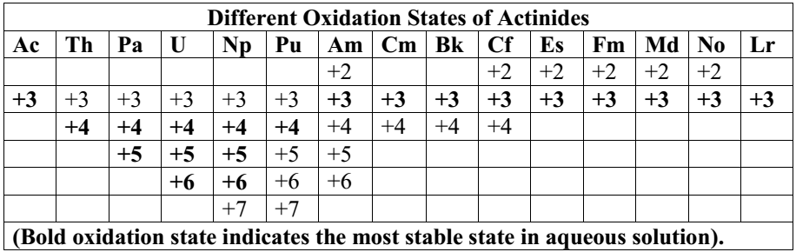
Oxidation state
The dominant oxidation state of actinides is +3 which shows increasing stability for the heavier elements
But, unlike lanthanides, actinides show a variety of oxidation states from +3 to +7 due to the very small energy gap between 5f, 6d and 7s sub shells
The principal oxidation states are +3 and +4
The +3 oxidation state is the most stable
The +4 oxidation state is the most stable in Th and Pu
+5 in Pa and Np and +6 is seen in U
In actinides, the distributions of oxidation states are uneven

Slide 25
Actinide contraction: There is a regular decrease in ionic radii with increase in atomic number from Th to Lr.
It is caused due to imperfect shielding of one 5f electron by another in the same shell.
This results in increase in the effective nuclear charge which causes contraction in size of the electron cloud.
Colour of the ions: Ions of actinides are generally coloured which is due to f–f transitions.
It depends upon the number of electrons in 5f orbitals.
Melting and Boiling points: The elements have fairly high melting and boiling points though the values are considerably lower than the transition elements.

Slide 26
Magnetic properties: actinide elements are strongly paramagnetic.
The magnetic-properties of actinide ions are more complicated than those of lanthanide ions and are usually lower than the calculated values.
This is due to
the fact that 5f electrons of actinides are less effectively shielded which results in quenching of orbital contribution.
the less sharply defined distinctions between 5f and 6d electrons as compared to 4f and 5d electrons
the lesser applicability of the expression as compared to that in the lanthanide elements
Atomic and Ionic radii: The sizes of the ions decreases regularly along the series because of the poor screening of the nuclear charge by the f-orbital results in an actinide contraction similar to the lanthanide contraction.
Density: All actinides except thorium and americium have high density.

Slide 27
Reactivities of Ac elements
They are highly reactive metals.
The reactivity’s of actinide elements are almost similar with lanthanide elements.
They react with O₂, H₂O, nonmetals(S, C, halogens, H₂, N₂) at moderate temperature.
The reactivity of Actinides metals increased when they are finely divided.

Slide 28
Uses of Actinides
The most useful actinides are thorium, uranium and plutonium
Thorium is used in the atomic reactors and in the treatment of cancer
Their salts are used in making incandescent gas mantles
Uranium is used as nuclear fuel
Their salts are used in the glass industry for imparting green color, ceramic industry, textile industry and in medicines too.
Plutonium is also used as nuclear fuel and for making atomic bombs

Slide 29
Similarities Between Lanthanides and Actinides
Both lanthanides and actinides involve the filling of f- orbitals
Both exhibit a common oxidation state of +3
Both are electropositive and reactive
Both exhibit magnetic and spectral properties
Lanthanides exhibit lanthanide contraction and actinides exhibit actinide contraction

Slide 30
Comparison of Lanthanides and Actinides
Lanthanides
Actinides
Besides +3, Ln show oxidation states of +2 and +4.
4f orbitals in Ln elements totally screened by 5s and 5p orbitals (do not participate in any chemical reaction at normal conditions).
Ln are poor in complex formation
Ln cpds are less basic.
Ln, except promethium, all are non-radioactive.
An show higher ox. States +4, +5, +6 and + 7 .
5f-orbitals extend into the space beyond 6s and 6p orbitals and participate in chemical reaction.
An have a greater tendency towards complex formation.
An cpds have appreciable basicity due to their high metallic character.
Almost all actinides are radioactive .

Slide 31
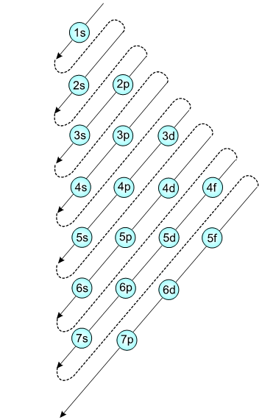
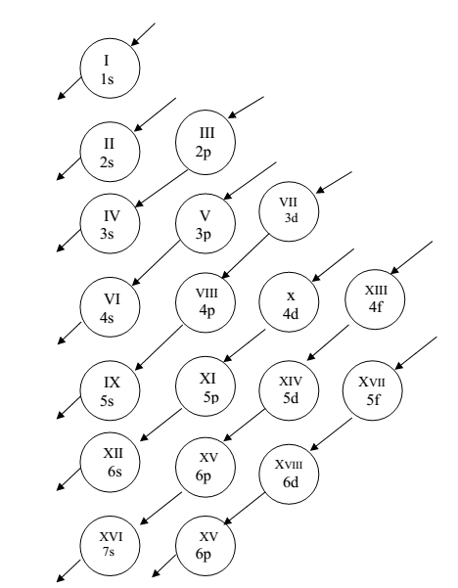
Or
7p

